Slide 1



Case 3
Frank
ASCVD with Multiple CV Risk Factors
ASCVD: atherosclerotic cardiovascular disease

Slide 2

Learning Objectives
Upon completion of this case based session, participants will be able to:
01
Identify patients with ASCVD and with multiple CV risk factors and those who have especially high risk features (eg: PAD)
02
Prioritize treatment options in alignment with patient priorities
03
Identify circumstances requiring use of statin-add-on therapies to achieve goal
04
Review safety and efficacy of PCSK9 inhibitors in specific high risk populations
05
Discuss safety and CV risk reduction benefits of very low LDL-C goals
ASCVD: atherosclerotic cardiovascular disease

Slide 3



Case 3
Frank
65 years old
Frank’s History
Used to be a heavy smoker and drinker
Had aortofemoral bypass surgery for peripheral vascular disease in 2007
CVA with full recovery in 2011 while on ASA
Recent nuclear scan for atypical chest pain shows area of fixed defect and mild area of distal anterior wall ischemia
Physical Exam
Weight 159 kg
Height 1.88 m
BMI 45 kg/m²
BP 140/88 mmHg
HR 70 regular
Popliteal and pedal pulses full

Slide 4


Case 3
Frank
65 years old
Medications
Clopidogrel 75 mg OD
Rosuvastatin 20 mg OD
Metoprolol 25 mg am and 50 mg pm
7 mg of perindopril and 5 mg of amlodipine
T2DM for 8 years
Myocardial Infarction 3 years ago (DES stent)
Hypertension x 10 years
Labs
A1C 6.3%
eGFR 65 ml/min
LDL-C 2.2 mmol/L
12 lead EKG, Q waves leads V1 to V3

Slide 5

What are your treatment priorities for Frank?
Diet, exercise and weight management?
BP control?
Lipid control?
Glucose Intolerance?
The patient’s personal health priority?

Slide 6

Case 3
Frank
65 years old
Frank decides that he wants to try to be more active, watch his diet and try to lose weight.
So you make no changes to his medications and ask him to return in 6-8 weeks.

Slide 7

Case 3
Follow-Up Visit – 8 weeks
Frank
65 years old
Physical Exam
Weight 157 kg (lost 2 kg since last visit)
BP 132/82 mmHg (140/88 mmHg previous visit)
Labs
A1C 6.3% (no change)
eGFR 65 ml/min (no change)
LDL-C 2.2 mmol/L (no change)

Slide 8
Case 3
Frank
65 years old
Frank indicates that it was more difficult than he anticipated to lose the 2 kg and is disappointed that his blood pressure and blood tests have not changed dramatically. He is most concerned about having another stroke.

Slide 9
What are your current treatment priorities for Frank?
BP control?
Lipid control?
Anticoagulation?
Glucose Intolerance?

Slide 10
Case 3
Frank
65 years old
Frank is reluctant to take more BP medications or anticoagulants and is convinced that he does not have diabetes because he avoids sugar.

Slide 11
Is it worthwhile addressing Frank’s LDL-C?

Slide 12


2016 CCS Lipid Guidelines Recommend: Targeting Lower LDL-C to Lower the Risk for CV Events
TREATMENT TARGETS:
STATIN INDICATED CONDITIONS
LDL-C consistently <2.0 mmol/L or >50% reduction
Consider <1.8 mmol/L in patients with clinical atherosclerosis
Apo B ≤0.80 g/L or non-HDL-C ≤2.6 mmol/L can be considered as alternative treatment targets
(those who will benefit the most):
Clinical atherosclerosis*
Abdominal aortic aneurysm
Most diabetes mellitus
CKD (age >50 years)
LDL-C ≥5.0 mmol/L
*Clinical atherosclerosis, i.e., previous MI, or coronary revascularization by PCI or CABG surgery, other arterial revascularization procedures, angina pectoris, cerebrovascular disease including TIA, or peripheral arterial disease (claudication and/or ABI <0.9)
ABI, ankle brachial index; Apo B, apolipoprotein B; CABG, coronary artery bypass graft surgery; CCS, Canadian Cardiovascular Society; CKD, chronic kidney disease; CV, cardiovascular; HDL-C, high-density lipoprotein cholesterol; LDL-C, low-density lipoprotein cholesterol; MI, myocardial infarction; PCI, percutaneous coronary intervention; TIA, transient ischemic attack.
Anderson TJ et al. 2016;32:1263-1282

Slide 13

What are your options for lowering Frank’s LDL-C
Frank is currently taking rosuvastin 20 mg OD
Please select from one of the available options
Use maximum dose rosuvastatin 40 mg
Add ezetimibe 10 mg to rosuvastatin 20 mg
Add ezetimibe 10 mg and increase rosuvastatin to 40 mg
Add a PCSK9 inhibitor

Slide 14

What LDL-C lowering expectations would you describe to Frank for each scenario?
Using a maximum dose rosuvastatin 40 mg?
“rule of 6%” suggests that LDL-C, on average, may fall insufficiently
to meet LDL-C target
Adding ezetimibe 10 mg to rosuvastatin 20 mg?
this may provide a 15 – 20% lowering of LDL-C (perhaps to about 1.8 mmol/L)
Adding ezetimibe 10 mg and increasing rosuvastatin to 40 mg?
on average a 20 – 25% fall is expected (perhaps to 1.7 mmol/L)
Adding a PCSK9 inhibitor?
on average, a 50-60% or more reduction would be expected (perhaps to 1.1 mmol or less)

Slide 15
Is there any evidence for use of a PCSK9 inhibitor in a patient with Frank’s profile?
Please select from one of the available options
Yes
No
Not Sure

Slide 16
FOURIER
Patients with Peripheral Artery Disease
27,564
Patients with Atherosclerosis Randomized
69%
Intermittent Claudication & ABI < 0.85 at Baseline
57%
Peripheral Revascularization (Median 3.7 years prior)
3,642
Patients with Symptomatic Lower Extremity Peripheral Artery Disease
42%
1517
26%
955
27%
1,044
1,505
Patients with Symptomatic Lower Extremity Peripheral Artery Disease and no prior MI or Stroke
27
19 41
39
4%
Amputation for
Ischemia
Bonaca MP et al; Circulation. 2018 Jan 23;137(4):338-350.

Slide 17
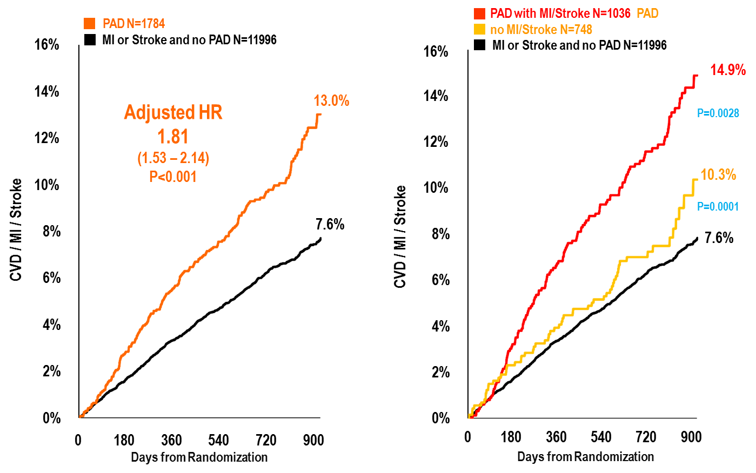
FOURIER
Peripheral Artery Disease and Risk in Placebo Patients
adjusted age, sex, race, BMI, diabetes, hypertension, smoking, eGFR, CHF, prior MI,
Bonaca MP et al; Circulation. 2018 Jan 23;137(4):338-350.
Notes:
Notes:
This patient would fall into the "PAD w MI/Stroke" category

Slide 18
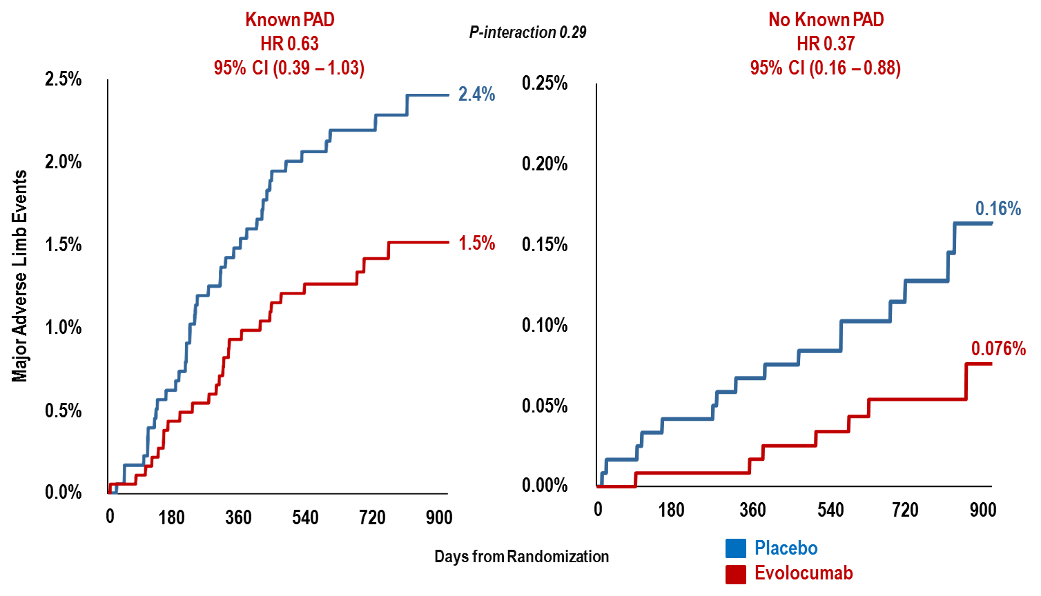
FOURIER
Major Adverse Limb Events in Patients with and without Known PAD
Note different scale of the 2 figures
Bonaca MP et al; Circulation. 2018 Jan 23;137(4):338-350.

Slide 19
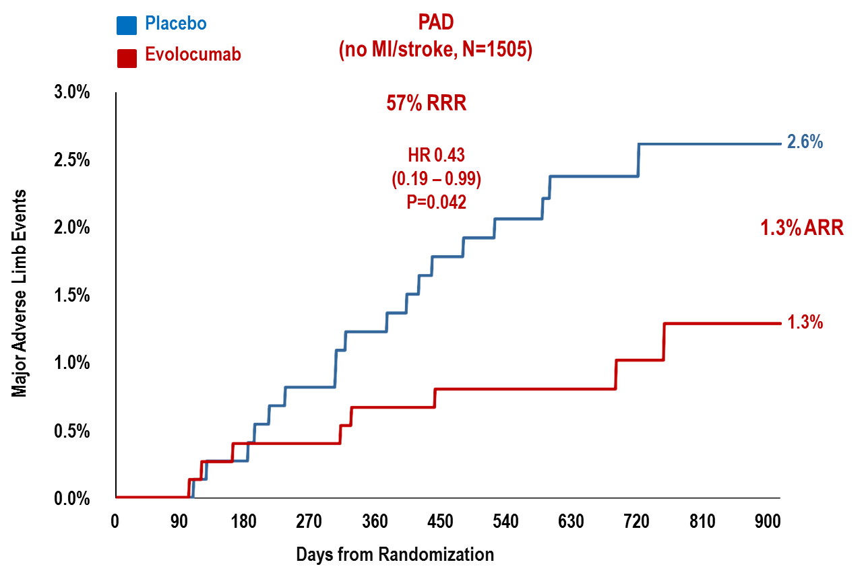
FOURIER
Major Adverse Limb Events in Patients with PAD and no MI or Stroke
Bonaca MP et al; Circulation. 2018 Jan 23;137(4):338-350.

Slide 20
Summary
Patients with PAD are at heightened risk of MACE and MALE
LDL-C lowering with evolocumab in patients with PAD:
Reduces major adverse CV events with robust ARR
Reduces major adverse limb events
Benefits extend to PAD without prior MI or stroke with an ARR for MACE or MALE of 6.3% (NNT 16) at 2.5 years
LDL-C reduction to very low levels should be considered in patients with PAD, regardless of history of MI or stroke, to reduce the risk of MACE and MALE
Bonaca MP et al; Circulation. 2018 Jan 23;137(4):338-350.

Slide 21
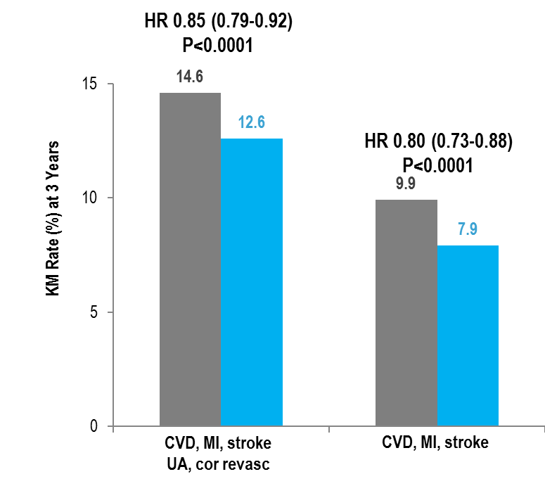
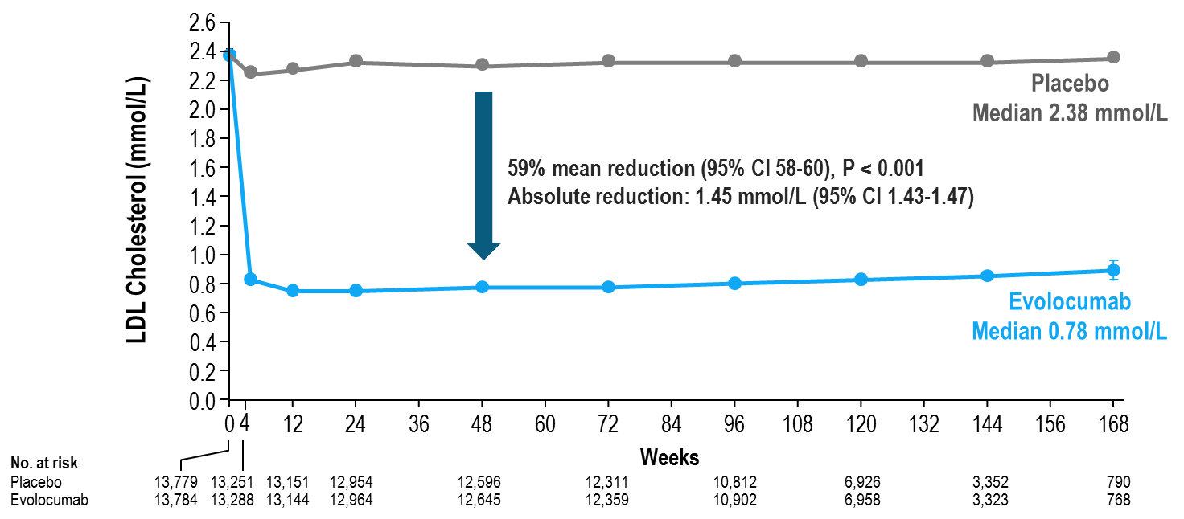
FOURIER
Median LDL-C Levels Over Time
LDL-C was significantly reduced in the evolocumab group (median: 0.78 mmol/L) including 42% who achieved levels ≤ 0.65 mmol/L vs < 0.1% in the placebo group
↓ CV outcomes in patients on statin
Safe and well-tolerated
Data shown are median values with 95% confidence intervals in the two arms; ITT. Sabatine MS, et al . N Engl J Med 2017; 376:1713-1722

Slide 22
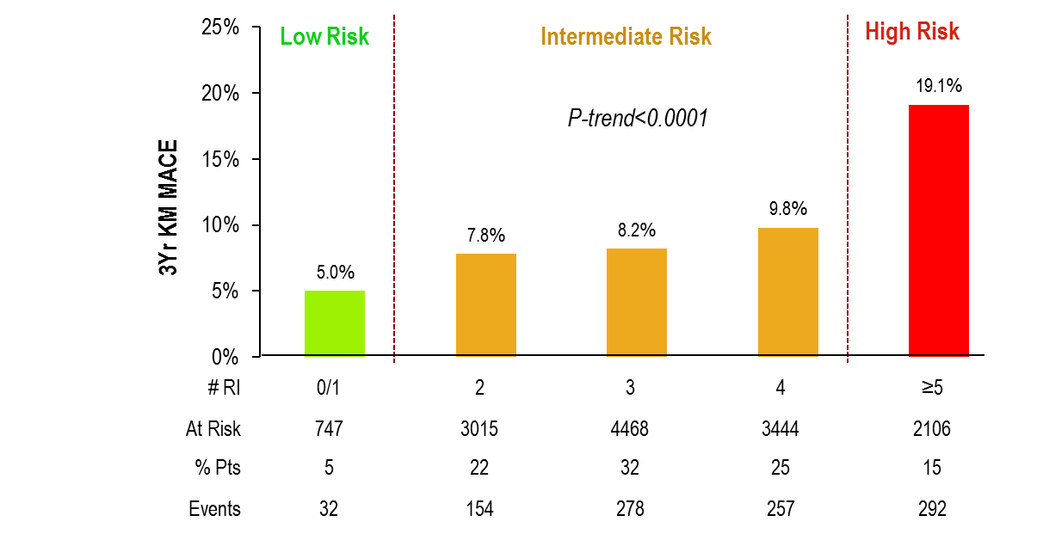
FOURIER
Risk Stratification for MACE with Placebo
TIMI Risk Score for Secondary Prevention (TRS 2ºP)
Risk Indicators | Points
CHF | 1
HTN | 1
Age ≥ 75 | 1
DM | 1
Prior Stroke | 1
Prior CABG | 1
PAD | 1
eGFR < 60 | 1
Current Smoking | 1
Prior MI | 1
Max Possible | 10
The integer-based scheme showed a strong, graded relationship with the rate of CV death, MI or CVA and the components at 3 yrs in both treatment arms (p-trend < 0.0001 for all endpoints; c-statistic = 0.61 [0.67 in prior validation set]).
Bohula EA et al, Atherothrombotic Risk Stratification and Magnitude of Benefit of Evolocumab in FOURIER, AHA 2017 Poster
Notes:
Thrombolysis in Myocardial Infarction (TIMI) Study Group

Slide 23
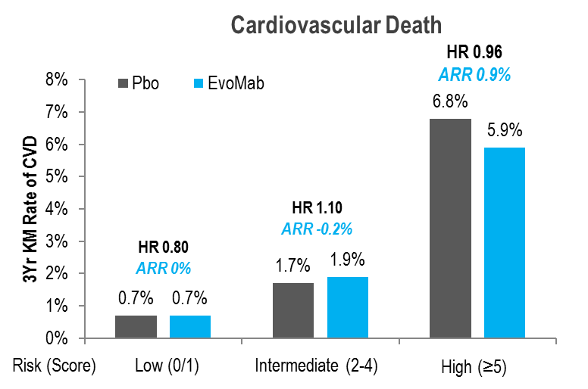
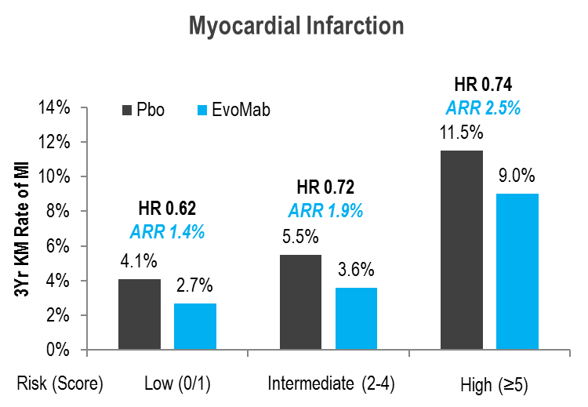
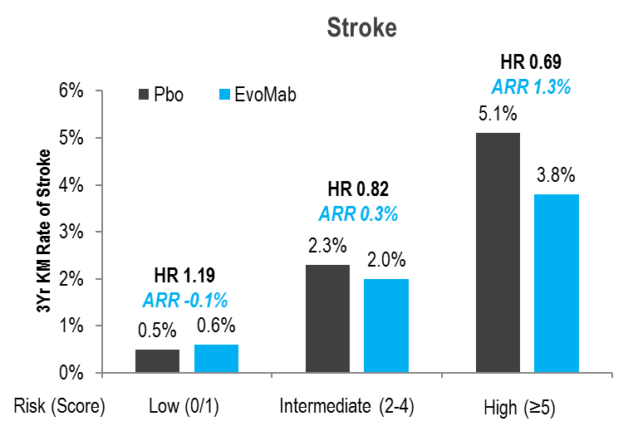
FOURIER
Individual Outcomes by Risk Category & Randomized Treatment
TIMI Risk Score for Secondary Prevention (TRS 2ºP)
Evaluation of individual endpoints showed a ARR in high-risk pts of 0.9% for CV death, 1.3% for CVA, and 2.5% for MI, respectively
P-trend<0.001 for all endpoints for both treatments. P-interaction > 0.05 for all endpoints
Bohula EA et al, Atherothrombotic Risk Stratification and Magnitude of Benefit of Evolocumab in FOURIER, AHA 2017 Poster
Notes:
Thrombolysis in Myocardial Infarction (TIMI) Study Group

Slide 24
Summary
In FOURIER, the TIMI Risk Score for Secondary Prevention (TRS 2ºP):
Predicted a gradient of risk for major adverse CV events
Identified high-risk pts w/ ASCVD who demonstrate a pattern of greater ARR in major CV events with evolocumab, with an NNT_{3Yr} ~ 25 in the highest risk.
This strategy may prove useful to personalize the intensification of secondary preventative therapies.
Bohula EA et al, Atherothrombotic Risk Stratification and Magnitude of Benefit of Evolocumab in FOURIER, AHA 2017 Poster

Slide 25
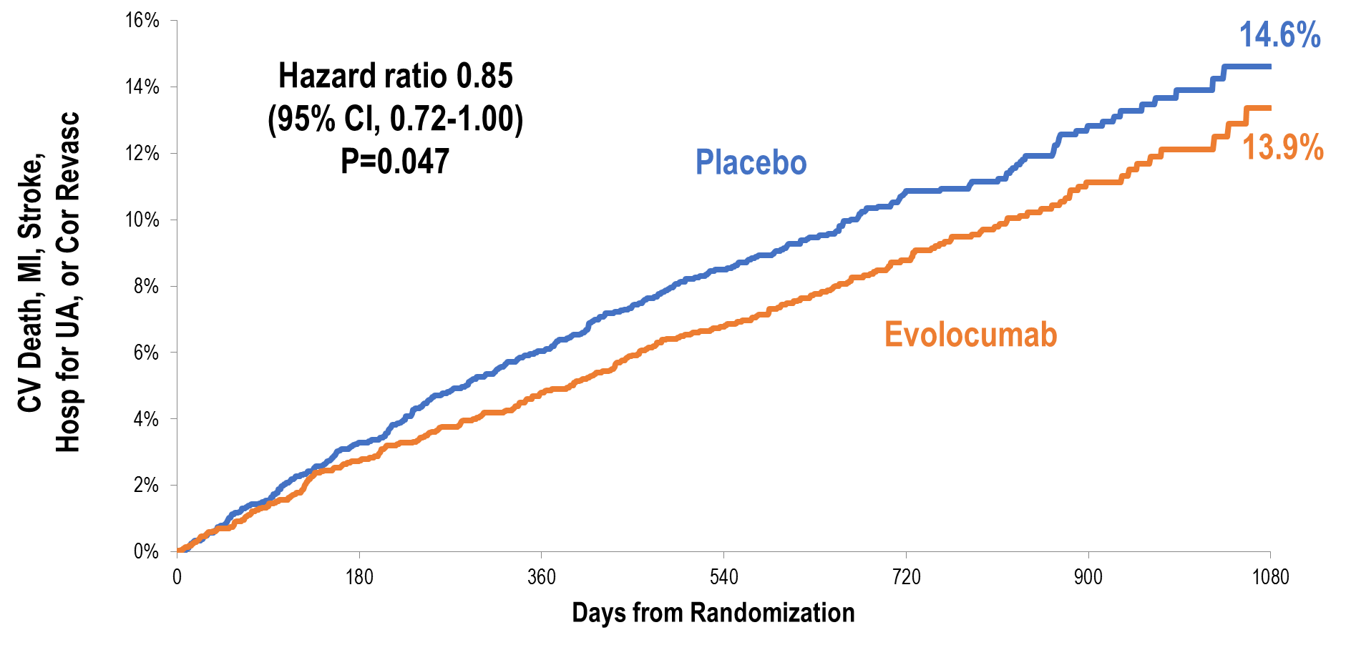
FOURIER
History of Stroke Cohort - Primary Endpoint
Patients with previous history of stroke:
Effect of evolocumab is similar to that for patients with other cardiovascular disease
Pedersen TR et al; presented at ESC 2017

Slide 26
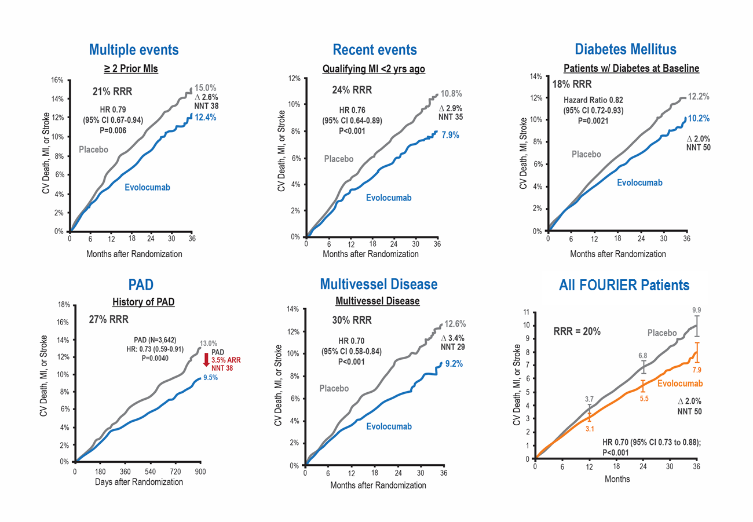
FOURIER Multiple High-Risk Patient Population Sub-Analysis
Sabatine MS, et al . AHA 2017 Poster
Notes:
Notes:

Slide 27
ODYSSEY Outcomes Study Design
Post-ACS (4-52 weeks) patients¹ age ≥40 yrs (n~18,000)
with LDL-C ≥1.81 mmol/L, or ApoB ≥ 0.8 g/L, or Non-HDL-C ≥ 2.59 mmol/L
despite high-intensity (or maximally tolerated) statin (atorvastatin 40-80 mg or rosuvastatin 20-40 mg/daily) x ≥2 wks ± other lipid-modifying therapy (e.g., ezetimibe, fenofibrate)²
Randomization³
Alirocumab 75 mg SC Q2wks x 2 months → 150 mg SC Q2wks based upon Month 1
LDL-C ≥ 1.3 mmol/L⁴ with dose titrated to maintain LDL-C in the 0.6-1.3 mmol/L target range
Placebo SC Q2wks
Primary Endpoint: Time to first CHD death/non-fatal MI/fatal and non-fatal ischemic stroke/unstable angina requiring hospitalization
Follow-Up: Minimum 24 months or target number of events (~1600) → estimated 11.4% rate at 4 yrs, 15% risk reduction; 90% power, 1-sided p=0.025, 1% lost
¹ Elevated troponin or CK-MB or resting ECG changes + obstructive coronary disease (new/presumed new ischemia/infarction
by perfusion imaging, regional wall motion abnormality, coronary stenosis ≥70% by angiography)
² Key exclusion criteria: Uncontrolled hypertension; NYHA III-IV or LVEF<25%;
prior hemorrhagic stroke; TG>4.52 mmol/L; hepatitis; eGFR<30 ml/min
² Following ≥2 wk (+ 5 days) run-in period with placebo (1 mL volume in an autoinjector) SC Q2wks
³ Titration downwards for very low LDL
Schwartz et al Am Heart J 2014;168:682-689.e1

Slide 28
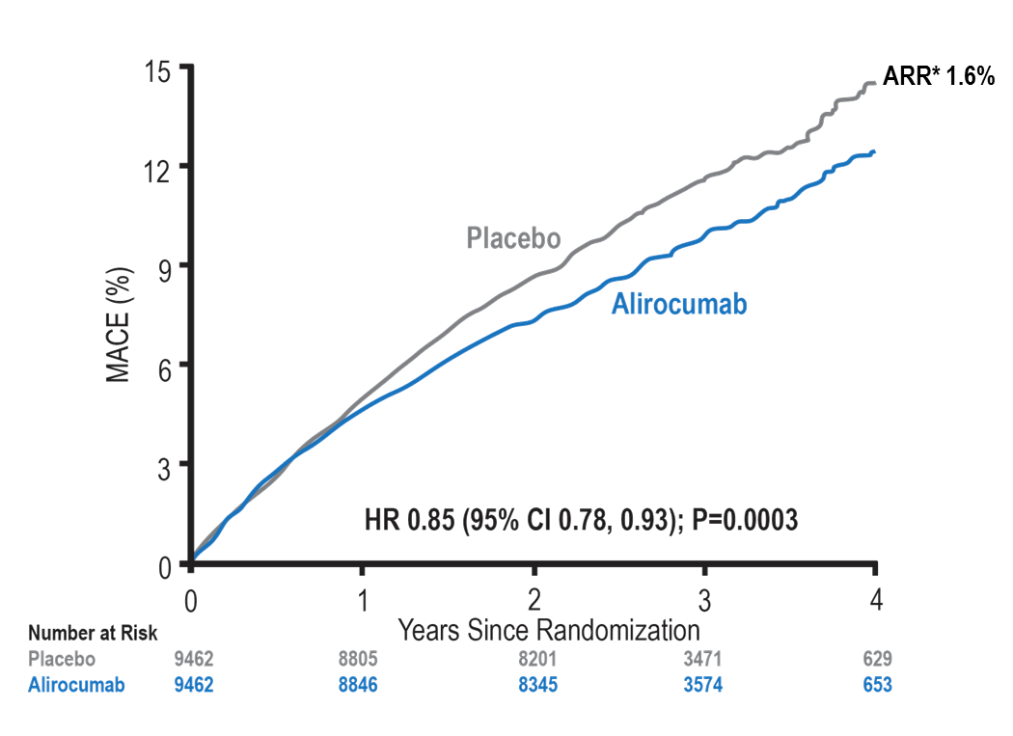
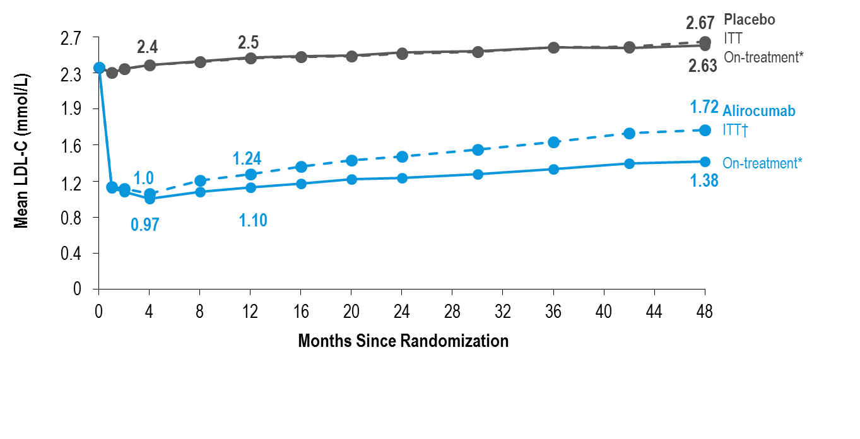
ODYSSEY Outcomes
LDL-C: ITT and On-Treatment Analyses & MACE
MACE: CHD death, non-fatal MI, ischemic stroke, or unstable angina requiring hospitalization
*Based on cumulative incidence
*Excludes LDL-C values after premature treatment discontinuation or blinded switch to placebo
†All LDL-C values, including those after premature treatment discontinuation, blinded down titration, or blinded switch to placebo
Steg G. et al; On behalf of the ODYSSEY OUTCOMES Investigators and Committees - American College of Cardiology – 67th Scientific Sessions - March 10, 2018

Slide 29
ODYSSEY Outcomes
Primary Efficacy Endpoint and Components
Endpoint, n (%) | Alirocumab (N=9462) | Placebo (N=9462) | HR (95% CI) | Log-rank P-value
MACE | 903 (9.5) | 1052 (11.1) | 0.85 (0.78, 0.93) | 0.0003
CHD death | 205 (2.2) | 222 (2.3) | 0.92 (0.76, 1.11) | 0.38
Non-fatal MI | 626 (6.6) | 722 (7.6) | 0.86 (0.77, 0.96) | 0.006
Ischemic stroke | 111 (1.2) | 152 (1.6) | 0.73 (0.57, 0.93) | 0.01
Unstable angina | 37 (0.4) | 60 (0.6) | 0.61 (0.41, 0.92) | 0.02
Steg G. et al; On behalf of the ODYSSEY OUTCOMES Investigators and Committees - American College of Cardiology – 67th Scientific Sessions - March 10, 2018

Slide 30
ODYSSEY Outcomes
Main Secondary Efficacy Endpoints - Hierarchical Testing
Endpoint, n (%) | Alirocumab (N=9462) | Placebo (N=9462) | HR (95% CI) | Log-rank P-value
CHD event | 1199 (12.7) | 1349 (14.3) | 0.88 (0.81, 0.95) | 0.001
Major CHD event | 793 (8.4) | 899 (9.5) | 0.88 (0.80, 0.96) | 0.006
CV event | 1301 (13.7) | 1474 (15.6) | 0.87 (0.81, 0.94) | 0.0003
Death, MI, ischemic stroke | 973 (10.3) | 1126 (11.9) | 0.86 (0.79, 0.93) | 0.0003
CHD death | 205 (2.2) | 222 (2.3) | 0.92 (0.76, 1.11) | 0.38
CV death | 240 (2.5) | 271 (2.9) | 0.88 (0.74, 1.05) | 0.15
All-cause death | 334 (3.5) | 392 (4.1) | 0.85 (0.73, 0.98) | 0.026*
*Nominal P-value
Steg G. et al; On behalf of the ODYSSEY OUTCOMES Investigators and Committees - American College of Cardiology – 67th Scientific Sessions - March 10, 2018

Slide 31
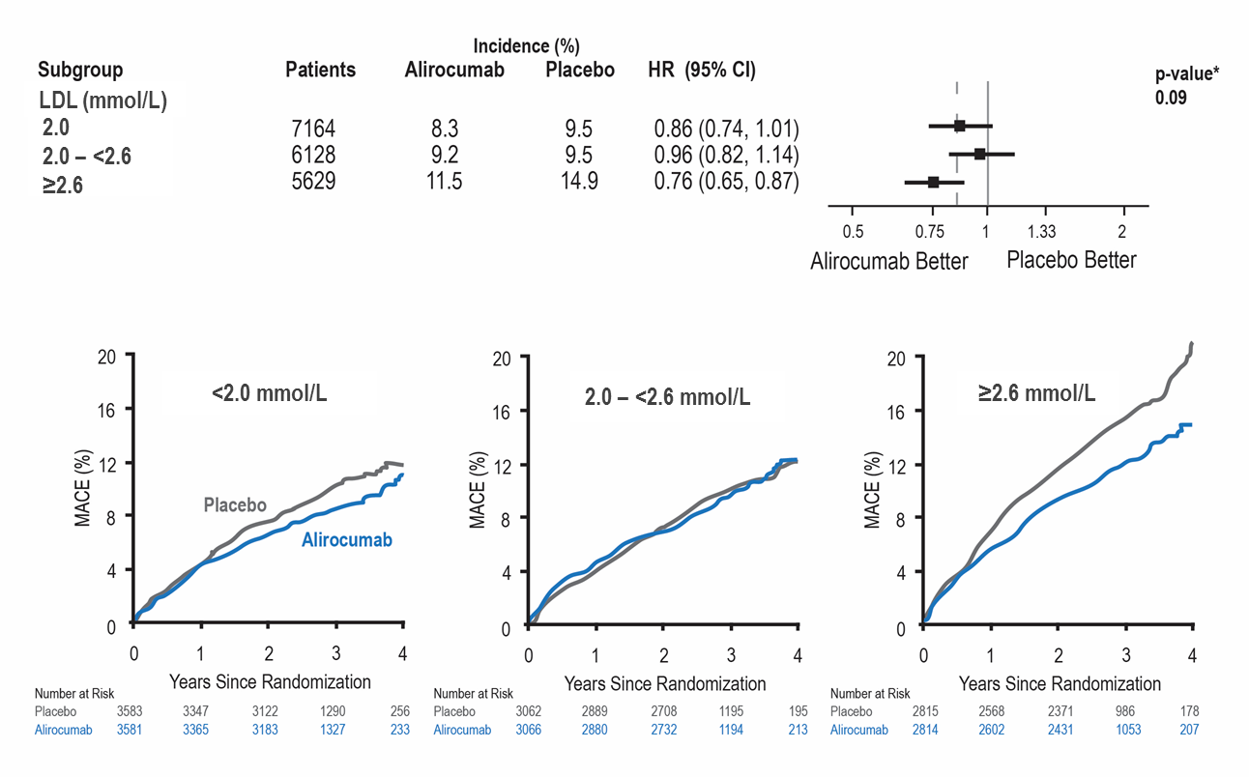
ODYSSEY Outcomes
Primary Efficacy in Main Prespecified Subgroups
*P-values for interaction
Steg G. et al; On behalf of the ODYSSEY OUTCOMES Investigators and Committees - American College of Cardiology – 67th Scientific Sessions - March 10, 2018

Slide 32
ODYSSEY Outcomes
Conclusions
Compared with placebo in patients with recent ACS, alirocumab 75 or 150 mg subcutaneous Q2W targeting LDL-C levels 0.6-1.3 mmol/L, and allowing levels as low as 0.4 mmol/L:
Reduced MACE, MI, and ischemic stroke
Was associated with a lower rate of all-cause death
Was safe and well-tolerated over the duration of the trial
Steg G. et al; On behalf of the ODYSSEY OUTCOMES Investigators and Committees - American College of Cardiology – 67th Scientific Sessions - March 10, 2018
Notes:
Notes
:

Slide 33
Case 3
Frank
65 years old
Frank has insurance and is interested in the PCSK9 inhibitor but is anxious to get on with therapy.
He reluctantly agrees to augment his rosuvastatin to 40 mg and to start ezetimibe while waiting for the paperwork approves his prescription of a PCSK9 inhibitor.
You see him after his 4th, q2wk injection.
LDL-C is 0.6 mmol/L and he is asymptomatic.

Slide 34
What is your next management step?
Please select from one of the available options
Shake Frank’s hand and make no changes to lipid management
Discontinue ezetimibe
Discontinue rosuvastatin
Discontinue ezetimibe and reduce rosuvastatin

Slide 35
Case 3
Frank
65 years old
Frank decides to stop ezetimibe, continue full dose rosuvastatin and PCSK9 inhibitor.
Follow-up visit shows LDL-C 0.8 mmol/L.

Slide 36
What is your next management step?
Please select from one of the available options
Shake Frank’s hand and make no changes to lipid management
Re-add ezetimibe
Discontinue rosuvastatin
Reduce rosuvastatin

Slide 37
Summary
Patients with ASCVD have high CV risk
Patients with ASCVD are at high CV risk and this risk varies greatly and is increased by patient specific features (eg: PAD)
In addition to best efforts to optimize diet, weight and activity, other modifiable risk factors must be addressed aggressively and with patient priorities in mind
Adjuncts to statin monotherapy, including PCSK9 inhibitors, are important adjuncts that will help achieve LDL-C goals
Evidence is emerging that very low LDL-C levels can now be achieved and substantially lower LDL-C can significantly lower residual risk

